Slide 1

UNIT-1

Slide 2
  Introduction to Data Structures
  Abstract data type (ADT)
  Stacks, Queues and Circular Queues and their implementation with arrays
  Stack Applications:
    Infix to Post fix conversion
    Postfix expression evaluation.
  Applications of Queues

Slide 3
Data can be represented in the form of binary digits in memory. A
binary digit can be stored using the basic unit of data called bit. A bit
can represent either a zero or a one.
Data means value or set of values or Data is a collection of raw facts.
Data structure is a way of storing and organizing data in an
efficient manner.
Any data structure is designed to organize data to suit a specific
purpose so that it can be accessed and worked in appropriate ways
both effectively and efficiently.

Slide 4
The main objective of the data structure is to store and retrieve the data in effectively and efficiently.
Mathematically, a data structure D is a triplet, that is, D=(d, f, a) where
D= data structure
d= a set of variables (data objects)
f= a set of functions
a= set of rules to implement the functions.

Slide 5
Classification of Data Structures
  Several data structures are available in the computer science
  and used based on their applications.
  Data structures are classified into different types.
Types
Linear Data Structures
Non Linear Data Structures
Arrays
Linked list
stack
queues
Trees
Graphs

Slide 6
Linear Data Structures: A data structure is said to be linear if its elements form a sequence or a linear list.
Non-linear Data Structures: A data structure is said to be non linear if its elements are not in a sequence. The elements in the data structure are not arranged in a linear manner; rather it has a branched structure.

Slide 7
Abstract Data Type (ADT)
Abstract Data Type is a
    Declaration of data and
Declaration of operations.
That is an Abstract Data Type (ADT) defines data together with the
operations.
ADT is specified independently of any particular implementation.
ADT depicts the basic nature or concept of the data structure rather
than the implementation details of the data.
A stack or a queue is an example of an ADT.
Both stacks and queues can be implemented using an array or using a
linked list.

Slide 8
Stack ADT Example
struct stack
{
int top, size;
};
void push();
void pop();
void display();

Slide 9
Stacks
A stack is a Last In First Out (LIFO) data structure in which all
insertions and deletions are takes place at one end, called the top.
Stack maintains a variable called top, which keeps track of the top
most element in the stack.
Any insertions or deletions should be based upon the value of top.
In the stack, the elements are removed in the reverse order of that in
which they were added to the stack that is last element inserted is
to be deleted first.
Basic Stack Operations:
push/insert : To insert an item into stack
pop/delete : To delete an item from stack
traverse/display : To display an items
isFull : To know whether the stack is full or not
isEmpty : To know whether the stack is empty or not

Slide 10
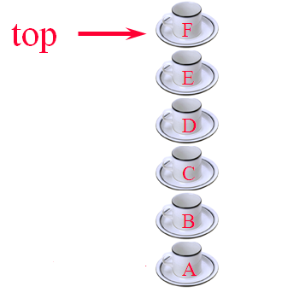
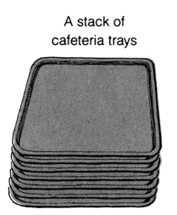

A stack of cups
A stack of coins

Slide 11
Example 1:
When the elements are inserted in the order as A,B,C,D then the size
of the stack is 4 and the top most element in the stack is D.
When deletion operation is performed on stack continuously then the order in which the elements are deleted is D,C,B,A.
D
top
C
top
C
B
top
B
A
top
A
B
A
A
C
top
B
B
top
A
A
A
top

Slide 12
Example 2: Here Stack Size is 4
3
3
3
2
2
2
1
1
TOP->
1
20
0
TOP->
0
10
0
10
TOP = -1
(Empty stack)
Push 10
Push 20
TOP->
TOP->
3
3
3
40
40
TOP->
2
30
2
30
2
30
1
20
1
20
1
20
0
10
0
10
0
10
Push 30
Push 40
Push 50
(Overflow)

Slide 13
3
3
TOP->
2
2
30
1
20
TOP->
1
20
0
10
0
10
pop
pop
3
3
2
2
1
1
TOP->
0
10
0
pop (TOP = -1)
underflow
pop

Slide 14
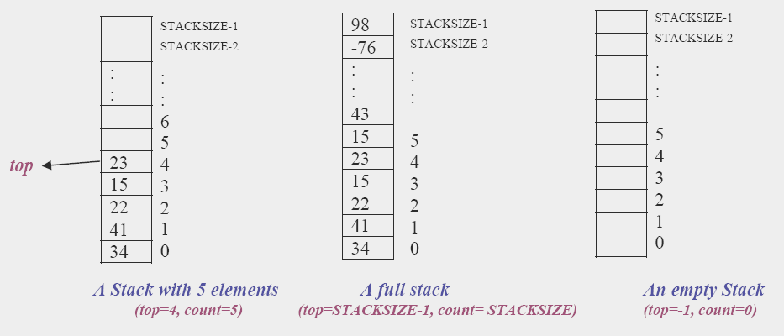
Example:3

Slide 15
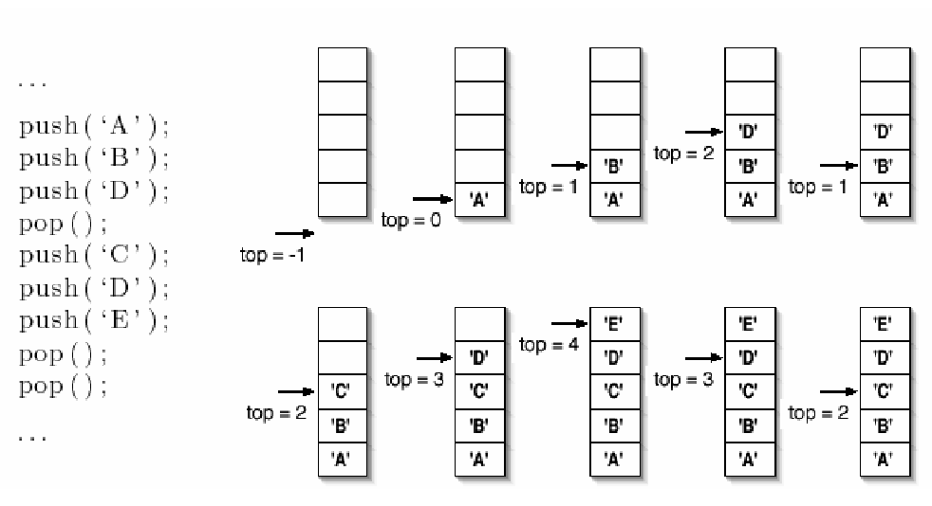
Example 4:

Slide 16
Implementing Stack using Array
A stack can be implemented either using an array or a linked list.
Procedure:
Initialize the stack by assigning -1 to the top variable to indicate that
the array based stack is empty.
A top is an integer value, which contains the array index for the top of
the stack.
Each time data is pushed or popped, top is incremented or
decremented accordingly, to keep track of the current top of the stack.
Stacks implemented as arrays are useful if a fixed amount of data is to
be used.

Slide 17
Algorithm for inserting an element into the stack
Algorithm push()
1. if top>=size then
1. print “stack is full”
2. else
1. read item
2. top=top+1
3. stack[top]=item
3. endif
4. stop
The first step of this algorithm checks for an overflow condition.
Overflow means inserting an item into a stack which is full.
If the top value reaches to maximum size of the stack then items cannot
be inserted into the stack i.e. stack is full.
Otherwise top is incremented by one and item is inserted into the stack.

Slide 18
Algorithm for deleting an element from the stack
Algorithm pop()
1. if top = -1 then
print “stack is empty”
2. else
1. item = stack[top]
2. top=top-1
3.endif
4.stop
The first step of this algorithm checks for underflow condition.
If the top value is -1 then stack is known as underflow or empty.
Takeout the element from the location where the top is pointing and store it in the variable then decrement top by one.

Slide 19
Algorithm for displaying an elements of the stack
Algorithm display()
1. if top = -1
1.print “stack empty”
2. else
1. for(i = top; i >= 0;i--)
1.print “stack[i]”
3.endif
4. stop
If the top value is -1 then the stack is empty.
If stack is not empty, assign top value to variable i, display the item which is pointed at stack[i] and decrement the top value by one and repeat this until top becomes zero.

Slide 20
/*1.Write a C program that implement stack and its operation by using the arrays.*/
#include<stdio.h> #include<stdlib.h> #define SIZE 4
void push(); void pop(); void display();
int isFull(); int isEmpty();
int choice,top=-1,stack[SIZE],item;
void main()
{
while(1) {
printf(" *** MENU ***\n 1. PUSH\n 2. POP\n 3.TRAVERSE\\DISPLAY\n 4.isFull\n 5.isEmpty\n 6.EXIT\n");
printf("enter your choice from menu:");
scanf("%d",&choice);
switch(choice) {
case 1 : push(); break;
case 2 : pop(); break;
case 3 : display(); break;
case 4 : isFull(); break;
case 5 : isEmpty(); break;
case 6 : exit(0);
default : printf("wrong choice\n");
}//switch
}//while
}//main

Slide 21
void push() {
if(top==SIZE-1)
printf("*** stack overflow(full) ***\n");
else
{
printf("enter the item to be pushed into the stack:");
scanf("%d",&item);
top++;
stack[top]=item;
}
}//push
void pop() {
if(top==-1)
printf("*** stack is empty ***\n");
else
{
item=stack[top];
top--;
printf("the deleted item from stack is %d\n",item);
}
}//pop

Slide 22
void display()
{
int i;
if(top==-1)
printf("**** stack underflow****");
else
{
printf("*** stack display ***\n");
for(i=top;i>=0;i--)
if(i==top)
printf("%d at %d ->top\n",stack[i],i);
else
printf("%d at %d\n",stack[i],i);
}
}
int isEmpty(){
if(top==-1)
printf("Stack is empty\n");
else
printf("Stack is not empty\n");
return 0;
}
int isFull()
{
if(top==SIZE-1)
printf("Stack is full\n");
else
printf("Stack is not full\n");
return 0;
}

Slide 23
Applications of Stack
The LIFO structure of the stack provides many applications of
stack.
Applications:
Reversing an array of elements.
Balancing the parentheses, braces, and brackets in a given expression or Parenthesis matching.
Converting an infix expression into RPN (Reverse Polish Notation).
Evaluating a postfix or RPN expression.

Slide 24
Reversing an array of elements
Very easy application is to reverse the order of a given array of items.
Algorithm reverse(string)
Initialize an empty stack.
while not the end of string
read a character
push it on to the stack
end while
while the stack is nonempty
pop a character
print it
end while

Slide 25
Parenthesis matching or Balancing Parentheses
The objective of this function is to check the matching of
parenthesis in an expression.
In an expression the number of left parenthesis must be equal to
number of right parenthesis.
Ex: ((A+B)*C)
This is a valid expression because in this
number of left parenthesis (2) = number of right parenthesis (2).

Slide 26
Balancing Parentheses
Algorithm Balance(String)
Initialize an empty stack.
Read a character.
While not the end of the String
  If the character is an opening bracket
    Push it onto the stack.
  Else if the character is a closing bracket
    Pop a character from the stack (report error if stack is empty).
    If this is not the corresponding opening bracket
      Report error.
    End if
  End if
End while
If the stack is empty
  Report well balanced parentheses
Else
  Report error
End if.

Slide 27
Types of expressions
Arithmetic expressions can be represented in three ways:
Infix notation: The operator/operation is in between the two operands.
Examples: A+B 2 + 3
Prefix (Polish notation): The operator precedes the operands.
Examples: +AB +23
Postfix (Reverse Polish Notation): The operator follows the operands.
Examples: AB+ 23+

Slide 28
Notations – Conversions
Consider the infix expression: 2 + 3 * (5 – 7) / 9
Let us insert implicit parentheses
(2 + ((3 * (5 – 7)) / 9))
Transfer the operators to the beginning of parentheses
(+ 2 (/ (* 3 (– 5 7)) 9))
Remove the parentheses: + 2 / * 3 – 5 7 9
This is the equivalent prefix expression.
Transfer the operators to the end of parentheses
(2 ((3 (5 7 –) *) 9 /) +)
Remove the parentheses: 2 3 5 7 – * 9 / +
This is the equivalent postfix expression.

Slide 29
Examples
Infix Expression | Prefix Expression | Postfix Expression
2 + 3 | + 2 3 | 2 3 +
2 + 3 * 5 | + 2 * 3 5 | 2 3 5 * +
(2 + 3) * 5 | * + 2 3 5 | 2 3 + 5 *
2 * 3 – (5 + 9) | – * 2 3 + 5 9 | 2 3 * 5 9 + –

Slide 30
Infix to Postfix (RPN) Conversion
Algorithm to convert infix expression to RPN:
Initialize an empty stack.
Repeat the following until the end of the infix expression is reached.
  Get next input token (constant, variable, arithmetic operator, left parenthesis, right parenthesis) in the infix expression.
  If the token is
    A left parenthesis: Push it onto the stack.
    A right parenthesis:
      Pop and display stack elements until a left parenthesis is on the top of the stack.
      Pop the left parenthesis also, but do not display it.
    An operator:
      While the stack is nonempty and token has lower or equal priority than stack top element, pop and display.
      Push token onto the stack.
    An operand: Display it.
When the end of the infix expression is reached, pop and display stack items until the stack is empty.
(Note: Left parenthesis in the stack has lowest priority)

Slide 31
An Example: 7-(2*3+5)*(8-4/2) → 723*5+842/-*-
Remaining Infix String Stack Postfix String
7-(2*3+5)*(8-4/2) empty null
-(2*3+5)*(8-4/2) empty 7
(2*3+5)*(8-4/2) - 7
2*3+5)*(8-4/2) -( 7
*3+5)*(8-4/2) -( 72
3+5)*(8-4/2) -(* 72
+5)*(8-4/2) -(* 723
5)*(8-4/2) -(+ 723*
)*(8-4/2) -(+ 723*5
*(8-4/2) - 723*5+
(8-4/2) -* 723*5+
8-4/2) -*( 723*5+
-4/2) -*( 723*5+8
4/2) -*(- 723*5+8
/2) -*(- 723*5+84
2) -*(-/ 723*5+84
) -*(-/ 723*5+842
null empty 723*5+842/-*-

Slide 32
/*3i).Write a C program that uses stack operations to perform convertion of infix expression into postfix expression.*/
#include<stdio.h> #include<ctype.h> #include<string.h> static char str[30]; int top=-1;
void main() {
char in[30],post[30],ch; int i,j,l;
printf("\n Enter the string(Infix Expression): ");
gets(in); l=strlen(in);
printf("\n The length of the given string is: %d\n",l);
for(i=0,j=0;i<l;i++)
if(isalpha(in[i]) || isdigit(in[i]))
post[j++]=in[i];
else {
if(in[i]=='(')
push(in[i]);
else
if(in[i]==')')
while((ch=pop())!='(')
post[j++]=ch;
else {
while(priority(in[i])<=priority(str[top]))
post[j++]=pop();
push(in[i]);
}//inner if
}//outer if

Slide 33
while(top!=-1)
post[j++]=pop();
post[j]='\0';
printf("\nEquivalent infix to postfix is:%s ",post);
getch();
}//main
push(char c) {
str[++top]=c;
return;
}//push
pop(){
return(str[top--]);
}//pop
priority (char c) {
switch(c) {
case '+':
case '-': return 1;
case '*':
case '/': return 2;
case '$': return 3;
case '^': return 4;
}//switch
return 0;
}//priority

Slide 34
Evaluation of Postfix (RPN) Expression
Algorithm to evaluate Postfix Expression:
Initialize an empty stack.
Do
  Get next token (constant, arithmetic operator) in RPN expression.
  If token is an operand, push it on the stack.
  If token is an operator do the following:
    Pop top two values from the stack. (If the stack does not contain two items, report error.)
    Apply operator token to these two values.
    Push the resulting value onto the stack.
Until the end of the expression is encountered.
The value of the expression is on the top of the stack (and stack should contain only this value).

Slide 35
Evaluate the postfix expression: 5,6,2,+,*,12,4,/,-
Remaining postfix String Symbol Scanned Stack
5 6 2 + * 12 4 / - no symbol empty
6 2 + * 12 4 / - 5 5
2 + * 12 4 / - 6 5 6
+ * 12 4 / - 2 5 6 2
* 12 4 / - + 5 8
12 4 / - * 40
4 / - 12 40 12
/ - 4 40 12 4
- / 40 3
null - 37

Slide 36
/*3ii).Write a C program that uses Stack operations to perform the evaluation of the postfix expression*/
#include<stdio.h>
#include<conio.h>
#include<math.h>
void main() {
char postfix[30],t[30];
int stack[10],top=-1,len,i,j,op2,op1,n;
clrscr();
printf("\n\n\nEnter the postfix:");
gets(postfix);
len=strlen(postfix);
postfix[len]=‘#';
for(i=0;postfix[i]!=‘#';i++)
{
j=0;
if(postfix[i]==' ')
continue;
if(postfix[i]=='+'||postfix[i]=='-'||postfix[i]=='*'||postfix[i]=='/'||postfix[i]=='^')
{
op2=stack[top--];
op1=stack[top--];

Slide 37
switch(postfix[i]) {
case '+': stack[++top]=op1+op2;
break;
case '-': stack[++top]=op1-op2;
break;
case '*': stack[++top]=op1*op2;
break;
case '/': stack[++top]=op1/op2;
break;
case '^': stack[++top]=pow(op1,op2);
break;
}
}
else {
while(postfix[i]!=' ‘) {
t[j++]=postfix[i++];
}
t[j]='\0';
n=atoi(t);
stack[++top]=n;
}
}
printf("\n\n\nResult=%d",stack[top]); getch();
}

Slide 38
Queues
A queue is a First In First Out (FIFO) data structure in which
elements are accessed from two different ends called Front and Rear. The elements are inserted into a queue through the Rear end and are removed from the Front end.
A queue maintains two variables called Front and Rear. Front refers
to the first position of the queue and Rear refers to the last position of
the queue.
In the Queue, the elements are removed in the order of that in which they were added to the queue, that is first element inserted is to be deleted first.

Slide 39
Basic Queue Operations:
Insertion: To add a new item to the rear end of the queue.
The rear end always points to the recently added element.
Deletion: To delete the item from front end of the queue.
The front end always points to the recently removed element.
Display: To display the items of queue.

Slide 40







Bus Stop Queue
Bus Stop
front
rear
rear
rear
rear
rear

Slide 41
Bus Stop Queue
Bus Stop
front
rear
rear
rear

Slide 42
Bus Stop Queue
Bus Stop
front
rear
rear

Slide 43

Bus Stop Queue
Bus Stop
front
rear
rear

Slide 44
front
rear
New people must enter the queue at the rear.
front
rear
People should leave the queue
from the front end.
rear
front
Notes:
When you think of a computer science queue, you can imagine a line of people waiting for a teller in a bank. The line has a front (the next person to be served) and a rear (the last person to arrive.

Slide 45
Types of Queues
  Linear Queue
  Circular Queue
  Double Ended Queue
  Priority Queue
Linear Queue: It is the one in which the insertions are takes
place at rear end and deletions are takes place at front end.
Circular Queue: It is the one in which the insertion of a new
element is done at the very first location of the queue if the last
location of the queue is full. i.e. circular queue is one in which the
first element comes just after the last element.

Slide 46
Double Ended Queue: It is a homogeneous list of elements in
which insertion and deletion operations are performed from both
the ends. They are also called as deque.
There are two types of deques:
Input-restricted deques and Output-restricted deques
Priority Queue: In priority queues, the items added to the queue
have a priority associated with them which determines the order in which they exit the queue. Items with highest priority are removed first.

Slide 47
Working of a linear queue:
i) Initially front=rear= -1. It indicates queue is empty.
0
1
2
3
4
front=rear=-1
ii) Add 10
iii) Add 20
0
1
2
3
4
0
1
2
3
4
10
10
20
front rear
front rear
iv) Add 30
v) Add 40
0
1
2
3
4
0
1
2
3
4
10
20
30
10
20
30
40
front rear
front rear

Slide 48
vi) Add 50
vii) Add 60 (overflow)
0
1
2
3
4
0
1
2
3
4
10
20
30
40
50
10
20
30
40
50
front rear
front rear
viii) delete (10 is removed)
ix) delete (20 is removed)
0
1
2
3
4
0
1
2
3
4
20
30
40
50
30
40
50
front rear
front rear

Slide 49
x) delete (30 is removed)
xi) delete (40 is removed)
0
1
2
3
4
0
1
2
3
4
40
50
50
front rear
front rear
xii) delete (50 is removed)
ix) delete (underflow)
0
1
2
3
4
0
1
2
3
4
rear
front
rear front

Slide 50
Implementing Queue using Array
A queue can be implemented either using an array or a linked list.
Procedure:
Initialize the queue by assigning -1 to the front & rear variables to
indicate that the array based queue is empty.
Each time data is inserted rear value is incremented by one and when
data is deleted front value is also incremented by one.

Slide 51
Algorithm for inserting an element into the queue
Algorithm insert()
1. if rear >= size-1 then
1. print “queue is full”
2. exit
2. else
1. if rear = -1 and front = -1
1. front = 0
2. endif
3. rear = rear + 1
4. queue[rear] = item
3. endif
4. stop
Explanation:
This procedure adds an item to the queue.
First it checks for an overflow condition.
If the rear value reaches or exceeds size of the queue then elements cannot be inserted into the queue. ie. Queue is full.
Whenever element is inserted into the queue, rear is increment by one and place the element in the location where rear is pointing.

Slide 52
Algorithm for deleting an element from the queue
Explanation:
This procedure deletes an element from the queue.
The first step of this algorithm checks for underflow condition.
If the front value is -1 or front > rear then queue is empty.
Take out the element from the location where, the front is pointing and store it in the variable, then increment front by one.
Algorithm delete()
1. if front = -1 or front > rear then
1. print “queue is empty”
2. exit
2. else
1. item = queue[front]
2. front = front + 1
3. endif
4. stop

Slide 53
Algorithm for displaying an elements from the queue
Algorithm display()
1. if front = = -1 or front > rear then
1. print “queue is empty”
2. exit
2. else
1. for(i = front; i <= rear; i++)
1. print “queue[i]”
3. endif
4. stop
If the front value is -1 or front > rear then the queue is empty.
If queue is not empty, display the item which is pointed at
queue[front] and increment the front value by one and
repeat this until front <= rear.

Slide 54
/*2. Write a C program that implement Queue and its operations using the arrays*/
#include<stdio.h> #include<stdlib.h> #define size 4
void insertion(); void deletion(); void display();
int front=-1,rear=-1,item,choice,queue[size];
void main() {
while(1) {
printf("\n*** MENU ***\n 1. INSERTION\n 2. DELETION\n 3.TRAVERSE\n 4. EXIT\n");
printf("enter your choice:");
scanf("%d",&choice);
switch(choice) {
case 1 : insertion();
break;
case 2 : deletion();
break;
case 3 : display();
break;
case 4 : exit(0);
default : printf("*** wrong choice ***\n");
}//switch
}//while
}//main

Slide 55
void insertion() {
if(rear>=size-1)
printf("*** queue is full ***\n");
else {
printf("enter item into queue:");
scanf("%d",&item);
rear++;
queue[rear] = item;
if(front = = -1)
front++;
}//else
}//insertion
void deletion() {
if((front = = -1)||(front>rear))
printf("*** queue is empty ***\n");
else
{
item = queue[front];
front++;
printf("the deleted item from queue is %d\n",item);
}//else
}//deletion
void display() {
int i;
if((front = = -1)||(front>rear))
printf("*** queue is empty ***\n");
else {
printf("\n elements in queue:- ");
for(i=front;i<=rear;i++)
printf("%d ",queue[i]);
}//else
}//display

Slide 56
Circular Queue:
It is the one in which the insertion of a new element is done at the very first location of the queue if the last location of the queue is full. i.e. circular queue is one in which the first element comes just after the last element.
A circular queue overcomes the problem of unutilized space in linear queues implemented as arrays.
A circular queue also have a Front and Rear to keep the track of elements to be deleted and inserted and therefore to maintain the unique characteristic of the queue.
Examples:
Print spooler of operating system
Revolvers bullet cylinder

Slide 57
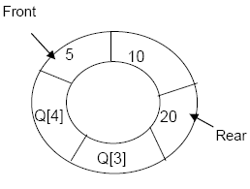
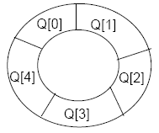
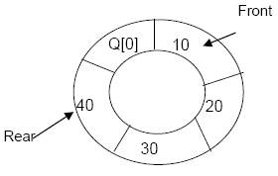
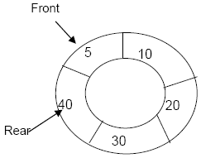
Circular Queue with size 5
After adding 5, 10, 20
After adding 30, 40
After deleting 5
Now Q[0] will be available in
the queue for another insertion

Slide 58
Insertion Algorithm:
if front == (rear+1)%size
  Queue is Overflow
if front == -1
  front = rear = 0
else
if rear == size - 1
  rear =0
else
  rear = rear + 1
read item;
cq[rear] = item
Deletion Algorithm:
if front = = -1
  Queue Underflow
delete item at cq[front]
if front = = rear
  front = -1;
  rear = -1;
else
if front = = SIZE-1
  front = 0;
else
  front = front+1;

Slide 59
Algorithm to Display :
front_pos = front, rear_pos = rear;
if front == -1
  Queue is empty
if front_pos <= rear_pos
  while front_pos <= rear_pos
    print cq[front_pos]
    front_pos++;
else
  while front_pos <= SIZE-1
    print cq[front_pos]
    front_pos++;
  front_pos = 0;
  while front_pos <= rear_pos
    print cq[front_pos]
    front_pos++;

Slide 60
/* Program for circular queue using array*/
# include<stdio.h> # include<stdlib.h> # define SIZE 4
int insert(); int del(); int display();
int cq[SIZE]; int front = -1; int rear = -1;
main() {
int choice;
while(1) {
printf("1.Insert\n 2.Delete\n 3.Display\n 4.Quit\n");
printf("Enter your choice : ");
scanf("%d",&choice);
switch(choice) {
case 1 : insert(); break;
case 2 : del(); break;
case 3: display(); break;
case 4: exit(0);
default: printf("Wrong choice\n");
}/*End of switch*/
}/*End of while */
}/*End of main()*/

Slide 61
int insert() {
int item;
if(front == (rear+1)%SIZE) {
printf("Queue Overflow \n");
return;
}
if (front == -1) { /*If queue is empty */
front = 0;
rear = 0;
}
else
if(rear == SIZE-1)/*rear is at last position of queue */
rear = 0;
else
rear = rear+1;
printf("Input the element for insertion in queue : ");
scanf("%d", &item);
cq[rear] = item ;
return;
}/*End of insert()*/

Slide 62
int del()
{
if (front == -1) {
printf("Queue Underflow\n");
return ;
}
printf("Element deleted from queue is : %d\n",cq[front]);
if(front == rear) { /* queue has only one element */
front = -1;
rear = -1;
}
else
if(front == SIZE-1)
front = 0;
else
front = front+1;
return;
}/*End of del() */

Slide 63
else
{
while(front_pos <= SIZE-1)
{
printf("%d ",cq[front_pos]);
front_pos++;
}
front_pos = 0;
while(front_pos <= rear_pos) {
printf("%d ",cq[front_pos]);
front_pos++;
}
}/*End of else */
printf("\n");
return;
}/*End of display() */
int display()
{
int front_pos = front,rear_pos = rear;
if(front == -1)
{
printf("Queue is empty\n");
return;
}
printf("Queue elements :\n");
if( front_pos <= rear_pos )
while(front_pos <= rear_pos)
{
printf("%d ",cq[front_pos]);
front_pos++;
}

Slide 64
Applications of Queue
There are several applications of queues in computer science.
Implements the various aspects of an operating systems.
CPU scheduling in Multiprogramming environment- single CPU has to serve more than one program simultaneously.
Round Robin CPU scheduling algorithm.
Operating System maintains a queue of processes that are ready to process or that are waiting for particular event to occur.
Printer maintains a queue.
Call waiting when you are attending other call
A file server in a computer network handles file access request from many clients throughout the network. Servers have a limited capacity to service request from clients, when that capacity is exceeded, client requests wait in queues.

Slide 65
Convert infix to postfix expression
(A-B)*(D/E)
(A+B^D)/(E-F)+G
A*(B+D)/E-F*(G+H/K)
((A+B)*D)^(E-F)
(A-B)/((D+E)*F)
((A+B)/D)^((E-F)*G)
12/(7-3)+2*(1+5)
5+3^2-8/4*3+6
6+2^3+9/3-4*5
6+2^3^2-4*5

Slide 66
Evaluate the postfix expression
5,3,+,2,*,6,9,7,-,/,-
3,5,+,6,4,-,*,4,1,-,2,^,+
3,1,+,2,^7,4,1,-,2,*,+,5.-

